Slide 1
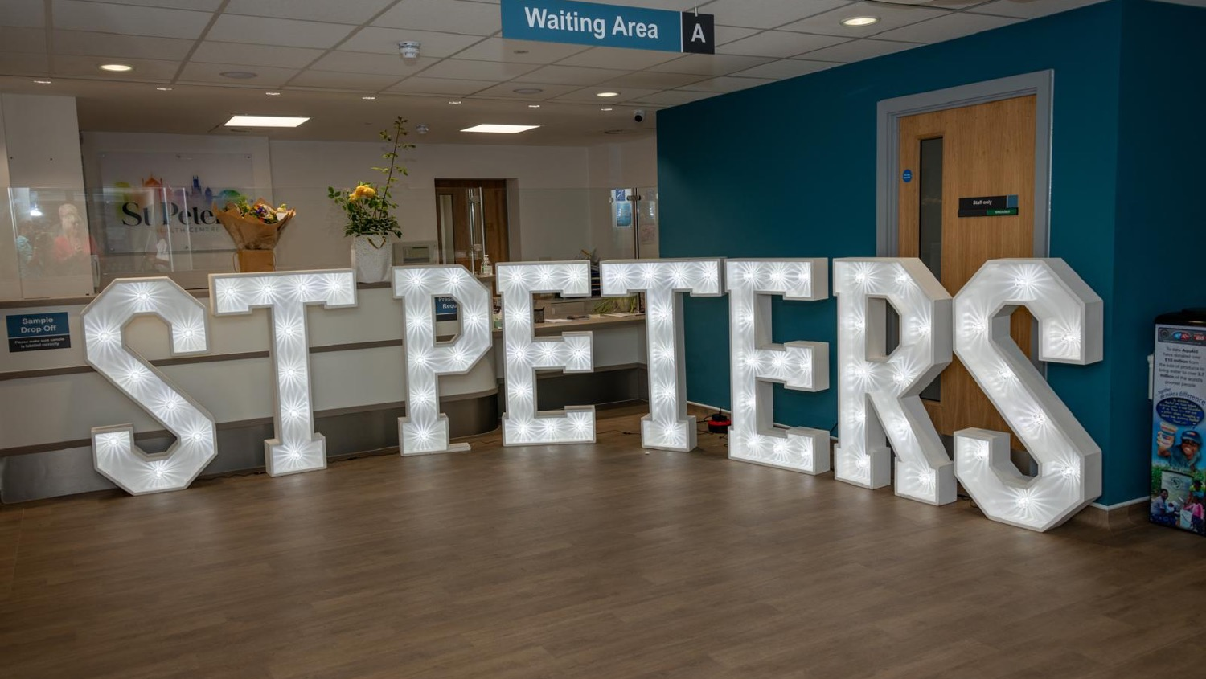
St Peter’s Patient Participation Group (PPG)

Slide 2
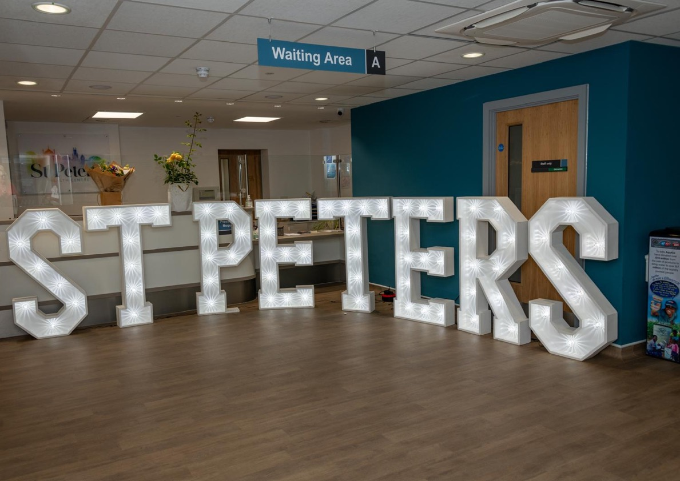
1. WELCOME to St Peter’s PPG!
PPG Committee – Who are we? What do we do?
Acting Chairperson (chairs the PPG Meetings): Joanne Smith
Acting Vice Chair (assists the chair and steps in when the chair is unavailable): Phillip Faithfull
Secretary (minutes meetings and supports the administrative work of the committee): role vacant
Committee Support Member (supports the wider work of the committee): Suzanne Hay
IT and Communications Lead (assist with the communication needs of the committee): Michael Collett

Slide 3
What is the PPG?
Members of the Patient Participation Group (PPG) are volunteers who support and influence healthcare at St Peter’s Health Centre by offering the patient’s perspective’ and acting as a ‘Critical Friend’. We work with the health centre to help find new ways of developing and improving services they provide.
The PPG will not deal with personal medical issues or complaints, as there are already well-established procedures that deal with these already in place.
The PPG group aims to meet three times a year to provide input and feedback into the development of services at the surgery and to discuss any related activities.
The Committee meets in-between to discuss with the leadership team at the practice, matters relating to the surgery, and for us to work together constructively to improve services

Slide 4
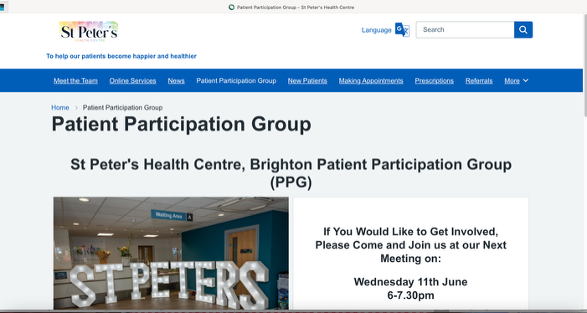
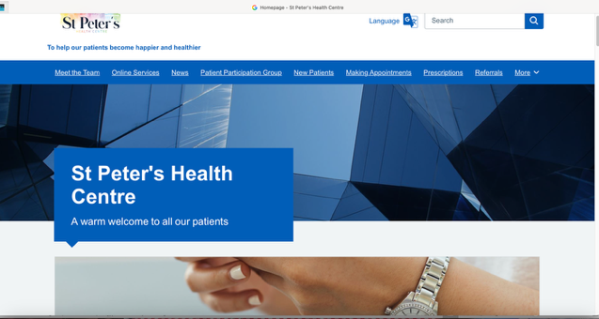
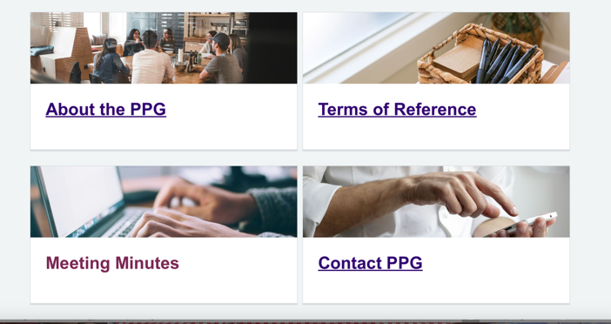
5. Information about St Peter’s PPG
https://www.stpetersmedicalcentre.co.uk/patient-participation-group
https://www.stpetersmedicalcentre.co.uk/

Slide 5
PPG Meeting Agenda
Wednesday 25th February 2026
6-7.30pm
Welcome and introductions (Joanne)
Agree the minutes from 24th September meeting (Joanne)
Matters Arising/Actions:
  Appointment text messaging system
  DNA (Did Not Attend) – current options for cancelling appointment
  Reminder - Triage system re: getting an appointment
St Peter’s update (Dr Jarvis)
5. PPG Updates (Joanne)
  Welcome to new PPG Committee members - Michael Colett & Suzanne Hay
  Benefits of using Robert Lodge – Phillip
  Feedback from PPG Sussex Network - Joanne
  World Menopause Day/Cafes – Joanne
  Health Awareness Events– e.g. Pharmacy First, Healthy Heart Day
6. Discussion Focus:
  Health Education
  Widening Community Engagement
7. AOB (Joanne)
  Date of next Public Meeting – Wednesday 3rd June tbc

Slide 6
4. Matters Arising:
Improving Appointment Cancellations - To make cancellations easier and reduce missed appointments, the surgery will explore the following:
Look at current cancellation options by telephone - The practice will review the cancellation options on the surgery's website. The goal is to make these features more prominent and user-friendly, ensuring patients can easily find and use them.
Text Message Reply Function - The surgery will explore a text message reply function that allows patients to cancel an appointment by simply texting back "CANCEL." This would provide a quick and convenient option for patients who prefer to manage appointments via text.
Enhancing Appointment Text Messages - To provide clearer and more useful information, the surgery will review and update its automated messaging system. Ideally to include key details requested by the PPG, such as:
  Healthcare Professional's Name: The name of the specific healthcare professional (e.g., GP, Nurse, Pharmacist) the patient is scheduled to see.
  Appointment Type: A clear description of the appointment type (e.g., face-to-face consultation, phone consultation, video call).
  Location/Contact Details: A reminder of the location for face-to-face appointments or instructions on how to receive a phone or video call.
Reminder about how online Triage System works

Slide 7

4. St Peter’s Health Centre update (Dr Jarvis)

Slide 8
New staff
We have 2 new Patient Care Advisors in our reception team – both called Carly!
We have a new nurse – Laura Hopgood, who is going to train in minor illness
We have two doctors in training – Dr Ben Hlatshwayo and and Dr Jaye Brunning
Dr Anna Faircloth is due back from Maternity Leave soon
Dr Claire Bowmer has left the Practice and we will be advertising for a new GP partners

Slide 9
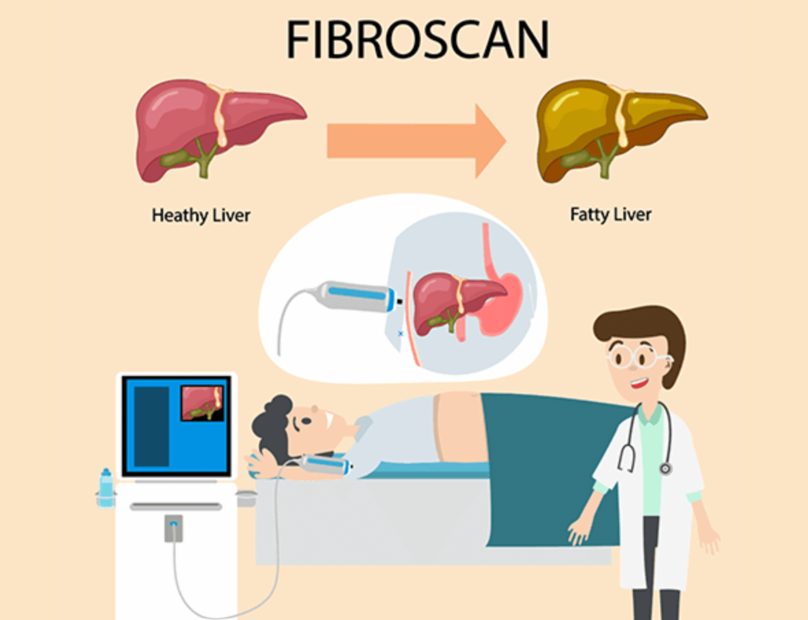
New Fibroscanning project
Two specialist nurses are now offering Fibroscanning at the Practice – we are the first surgery in the PCN to have in house access for this
It is a quick and painless state of the art investigation of liver health
Patients have been invited if they drink over 35 units of alcohol a week, or are diabetics who have a BMI over 30, or are people known to have fatty liver disease – we have been thrilled with the response and now have a waiting list

Slide 10
New Respiratory Hub
We are working with 2 other practices in the PCN (Wellsbourne and Park Crescent) to book in patients with COPD and Asthma to see a Consultant and Specialist Nurse at Robert Lodge in Whitehawk
This is aimed at people who might find attending a traditional hospital appointment more difficult, and staff also provide support with exercise , mental health resources and advice on benefits and keeping homes warm

Slide 11

New ADHD service
Brighton GP Federation is working with colleagues in Hastings and Crawley to set up a new service to diagnose and treat people with ADHD.
GPs and Mental health practitioners with special training and clinical supervision from Mental Health (SPFT) Consultants will start seeing people in March
This should improve access and quality for people and, if it is successful, could expand into autism and services from children

Slide 12
Appointment data
StstmConnect submissions generally remain high – but many people (approx. 60%) do not complete online

Slide 13
Appointments data
Our Triage team are meeting to try and improve our systems – we are investigating an AI system to help reduce queuing on the phone
Call volumes are up

Slide 14
Appointments data
Clinician | Finished | DNA | % DNA
Doctor | 2102 | 55 | 2.5%
HCA | 568 | 75 | 11.7%
HCP | 92 | 3 | 3.2%
MHN | 382 | 30 | 7.3%
Nurse | 876 | 82 | 8.6%
Pharm Team | 532 | 16 | 2.9%
Phlebotomy | 279 | 45 | 13.9%
Did Not Attends (DNAs) are also up

Slide 15

How can the PPG help?
We have revised our text messages – has anyone had any recently, and if so, are they clearer ?
We are buying a new bigger tablet for patients to consider filling in an online form in the waiting room – could anyone help people to navigate this ?
Do you have any other ideas to reduce DNAs ?

Slide 16
End of the Quality Outcomes Framework (QOF)year
In April we will have the final figures for achieving quality targets on treatment of people with long term conditions including
High Blood Pressure
Learning Disability
Serious Mental Illness
Diabetes
Dementia
Vascular Disease
Asthma
COPD
If you get a text to let us know your BP, weight or smoking status, or if you are invited in for a review please respond – it helps our targets and Practice funding

Slide 17

Every Friday at Robert Lodge
35-70, Robert Lodge Community Space, Manor Place, Brighton, BN2 5FG
Our East Brighton Health Hub is a drop-in service based in Robert Lodge every Friday (10am-1pm)
This is a free NHS open access service where our staff will be offering a variety of advice, support, and information to all ECBPCN patients. Our aim is to have a variety of healthcare professionals in one place, which will vary week to week.
This will include Occupational Therapists, Social Prescribers and Mental Health Support Workers. Staff will be there to welcome you and support you in finding the most appropriate team/advice you need. If you are registered with one of our 9 GP practices, come in for a cup of tea and a chat any Friday from 10am until 1pm.
Our social prescriber Joe Walker is also at St Peters on Tuesday afternoons – appointments can be booked at reception

Slide 18
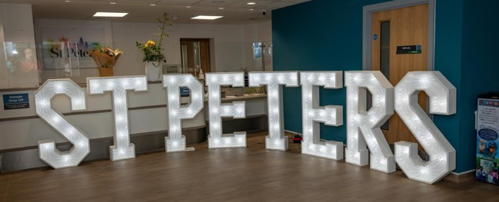
5. PPG Updates (Joanne)
  Welcome to new PPG Committee members - Michael Colett & Suzanne Hay
  Benefits of using Robert Lodge – Phillip
  Feedback from PPG Sussex Network - Joanne
  World Menopause Day/Cafes – Joanne
  Health Awareness Events– e.g. Pharmacy First, Healthy Heart Day
6. Discussion Focus:
  Health Education
  Widening Community Engagement

Slide 19
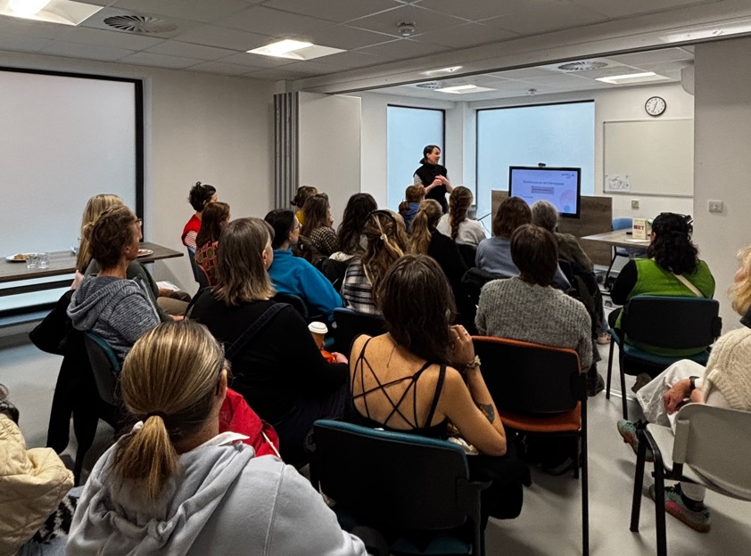
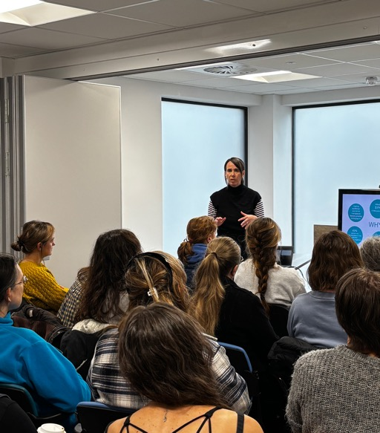

Community Support Groups & Education (Joanne)

Slide 20
6. Discussion Focus:
  Health Education
  Widening Community Engagement

Slide 21
8. AOB
Next PPG meeting: Wednesday 3rd June - date tbc

